Slide 1
AI26501 / MINI PROJECT
Obesity Level
Prediction
PREDICT
Insufficient
Normal
Comparing model performance and feature explanations
Overweight
Obesity
MTech AI/ML · Semester I · 2026
7 target categories
Presented by: Pratik Kumar (MT/AI/10004/26)
Soham Maity (MT/AI/10015/26)
MTech AI/ML MAI
Notes:
Opening: Introduce the project and the central idea — obesity-level classification from physical and lifestyle features. Add your actual team names before presenting.

Slide 2
01 · CONTEXT
Why predict obesity level?
The task is a multi-class classification problem using lifestyle and physical-condition information.
THE PROBLEM
PROJECT GOAL
Obesity status is associated with more
than one factor.
Classify each record into one of
seven obesity-related categories.
• Physical measurements such as age, height and weight
• Eating patterns, water intake and activity
• Family history and daily habits
The model is a decision-support experiment, not a medical diagnosis.
MTech AI/ML MAI
02
Notes:
Explain the classification target and why a model should use more than body measurements alone. State clearly that this is an academic model, not a clinical diagnostic tool.

Slide 3
02 · RESEARCH FOCUS
Research question & hypothesis
Based on Assignment 10: compare predictive performance and explanation consistency across at least two models.
RESEARCH QUESTION
HYPOTHESIS
When two classifiers perform well on the
same task, do they rely on the same features?
Similar predictive scores may
still produce different feature
rankings.
We compare Random Forest and Extra Trees using SHAP-based feature
explanations.
Tested with Top-5 overlap and Spearman rank correlation.
MTech AI/ML MAI
03
Notes:
Connect this slide explicitly to Assignment 10. The experiment asks whether classifiers with good predictive performance produce similar feature explanations. Present the hypothesis as something tested, not a proven fact.

Slide 4
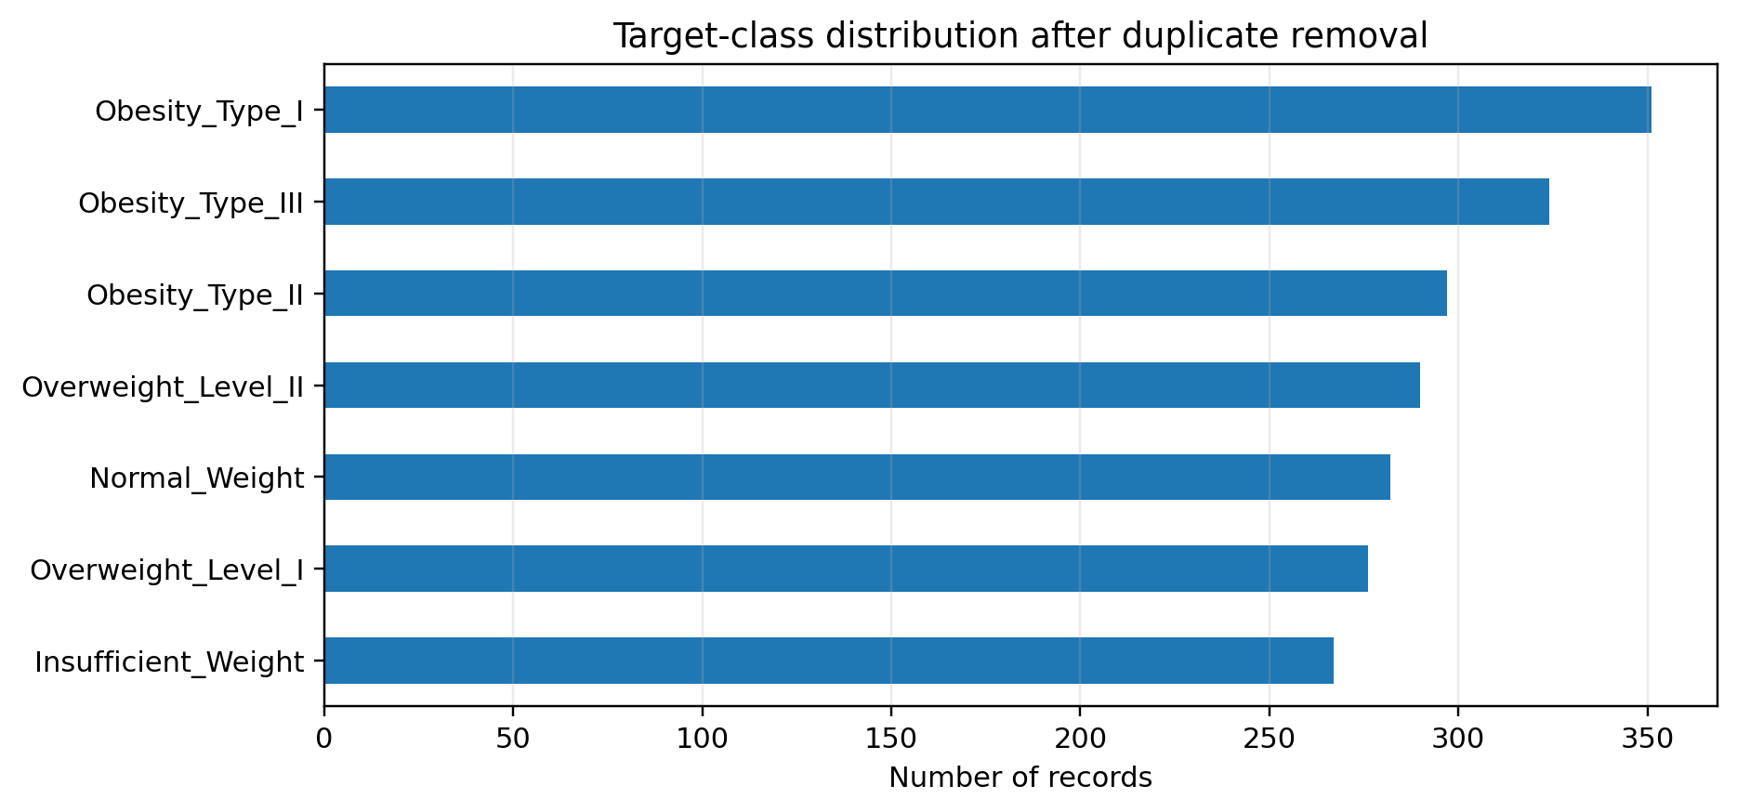
03 · DATA
Dataset at a glance
Notebook : ObesityDataSet_raw_and_data_sinthetic.csv
2,111
2,087
17
7
Original records
Records used
Columns
Target classes
Before duplicate removal
24 duplicates removed
16 input features + target
NObeyesdad
FEATURE GROUPS
• Physical: age, height, weight
• Behavioural: food, water, activity
• Categorical: gender, family history, transport
MTech AI/ML MAI
04
Notes:
Describe the source data carefully. There are 2,111 rows and 17 columns in the original CSV. The notebook removes 24 duplicates, leaving 2,087 rows. It reports no missing values. The filename suggests raw and synthetic records; the repo does not document provenance details.

Slide 5
04 · METHODOLGY
What was done
A compact view of the workflow in the submitted notebook.
01
02
03
04
05
06
Load & inspect
Clean
Outlier analysis
Prepare features
Train models
Explain & compare
→
→
→
→
→
Read CSV; inspect shape, types, class counts and missing values.
Remove 24 duplicate rows; no null values were reported.
Retain valid extreme values that may represent real obesity-related cases.
Separate numeric and categorical columns; preprocess before model fitting.
Fit Random Forest and Extra Trees classifiers.
Use SHAP, group encoded features, compare Top-5 overlap and rank correlation.
Evaluation: Accuracy · Macro-F1 · Top-5 Feature Overlap · Spearman Rank Correlation
MTech AI/ML MAI
05
Notes:
Walk through the notebook pipeline. Be ready to explain the categorical/numerical preprocessing cells. The deck summarizes the main stages rather than showing code.

Slide 6
05 · EXPERIMENT
Experimental setup
Two tree-ensemble classifiers were evaluated on the same seven-class prediction task.
MODEL COMPARISON
EXPLANATION COMPARISON
Random Forest
SHAP feature contributions
Ensemble of decision trees trained on bootstrapped samples.
• Encoded features were grouped back to original variables.
• Mean absolute grouped SHAP values were ranked.
• Top-5 overlap and Spearman correlation were calculated.
Extra Trees
Tree ensemble with additional randomisation in split selection.
MTech AI/ML MAI
06
Notes:
Explain the two tree ensembles and SHAP comparison. If asked, show the notebook cells and code to explain one-hot encoded feature grouping.

Slide 7
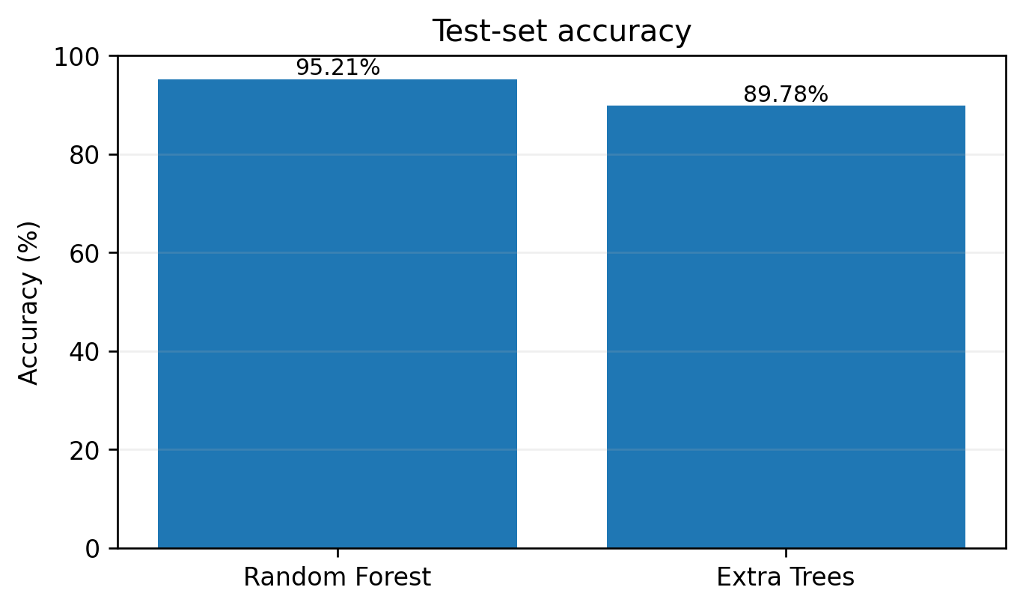
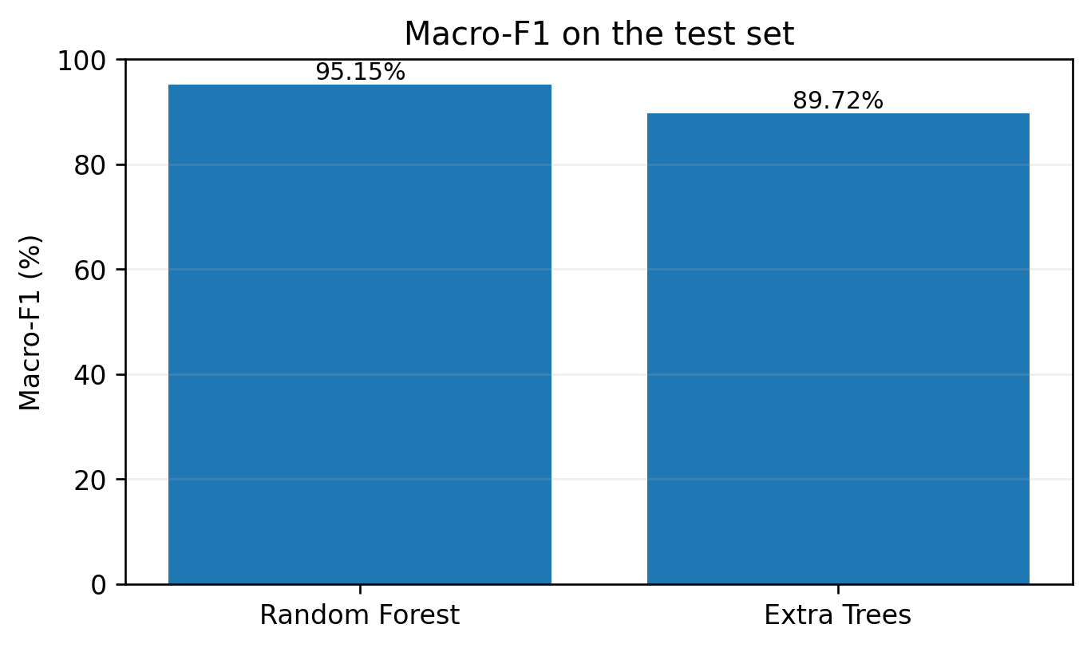
06 · RESULTS
Predictive performance
Values below are taken from the notebook’s saved final_results table.
Random Forest leads by 5.43 percentage points in both accuracy and Macro-F1.
Accuracy: RF 0.9521 · Extra Trees 0.8978 | Macro-F1: RF 0.9515 · Extra Trees 0.8972
MTech AI/ML MAI
07
Notes:
Read the figures directly. Random Forest reports 95.21% test accuracy and 95.15% Macro-F1. Extra Trees reports 89.78% and 89.72%. These are notebook-reported numbers; avoid claiming independent reproduction.

Slide 8
07 · EXPLAINABILITY
Do the models explain predictions similarly?
Top-ranked features from grouped SHAP values.
RANDOM FOREST · TOP 5
EXTRA TREES · TOP 5
1
Weight
1
Weight
2
FCVC
2
Gender
3
Gender
3
CALC
4
Age
4
Family history
5
Height
5
CAEC
40%
0.80
The overall ranking is related, but the
top-five sets differ.
Top-5 overlap
Spearman correlation
2 shared: Weight, Gender
Feature-rank association
MTech AI/ML MAI
08
Notes:
Explain that Weight and Gender appear in both Top-5 lists. The lists are not identical: RF also includes FCVC, Age and Height; Extra Trees includes CALC, family history and CAEC. Overlap = 2/5 = 40%.

Slide 9
08 · INTERPRETATION
What the results tell us — and what they do not
Keep the performance result separate from the explanation-consistency result.
\
MAIN FINDING
LIMITATIONS / NEXT STEPS
• The dataset is small and includes few synthetic records.
• To add repeated cross-validation and confidence
intervals.
• Inspect class-wise errors and test explanation
stability across folds.
Better prediction did not mean identical
explanations.
• Random Forest performed better on the reported test metrics.
• Only two of the five highest-ranked features were shared.
• Spearman ρ = 0.80 indicates a positive ranking association.
Takeaway: evaluate both how well a model predicts and how consistently it explains its decisions.
MTech AI/ML MAI
09
Notes:
Discuss the gap between prediction and explanation consistency. Limitations: repository documentation is sparse; no external validation or repeated CV evidence shown in the inspected notebook. Further work can strengthen robustness and error analysis.

Slide 10
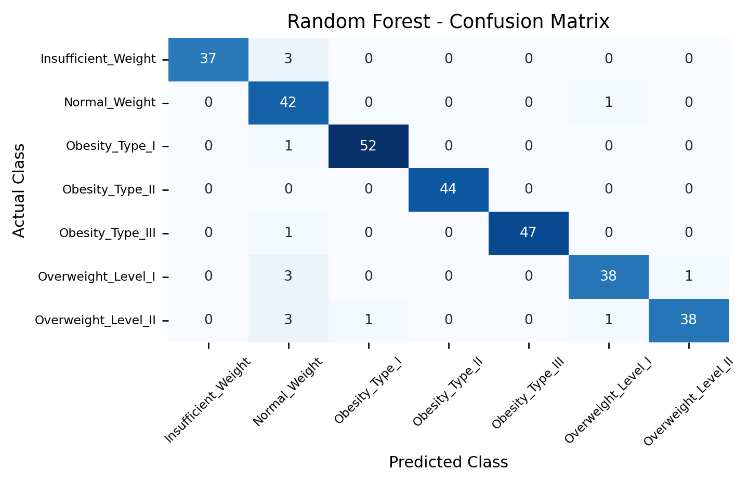
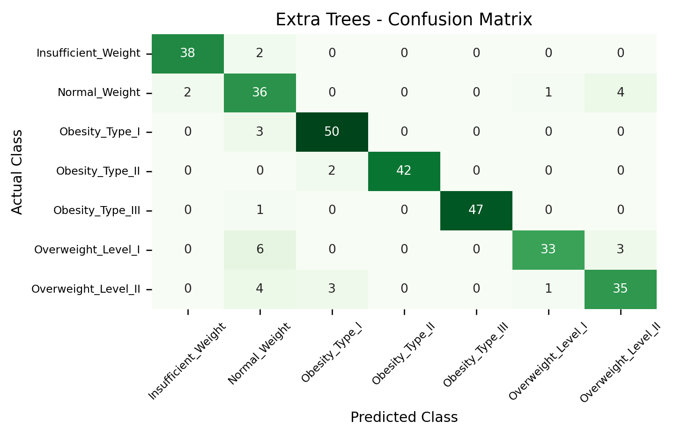
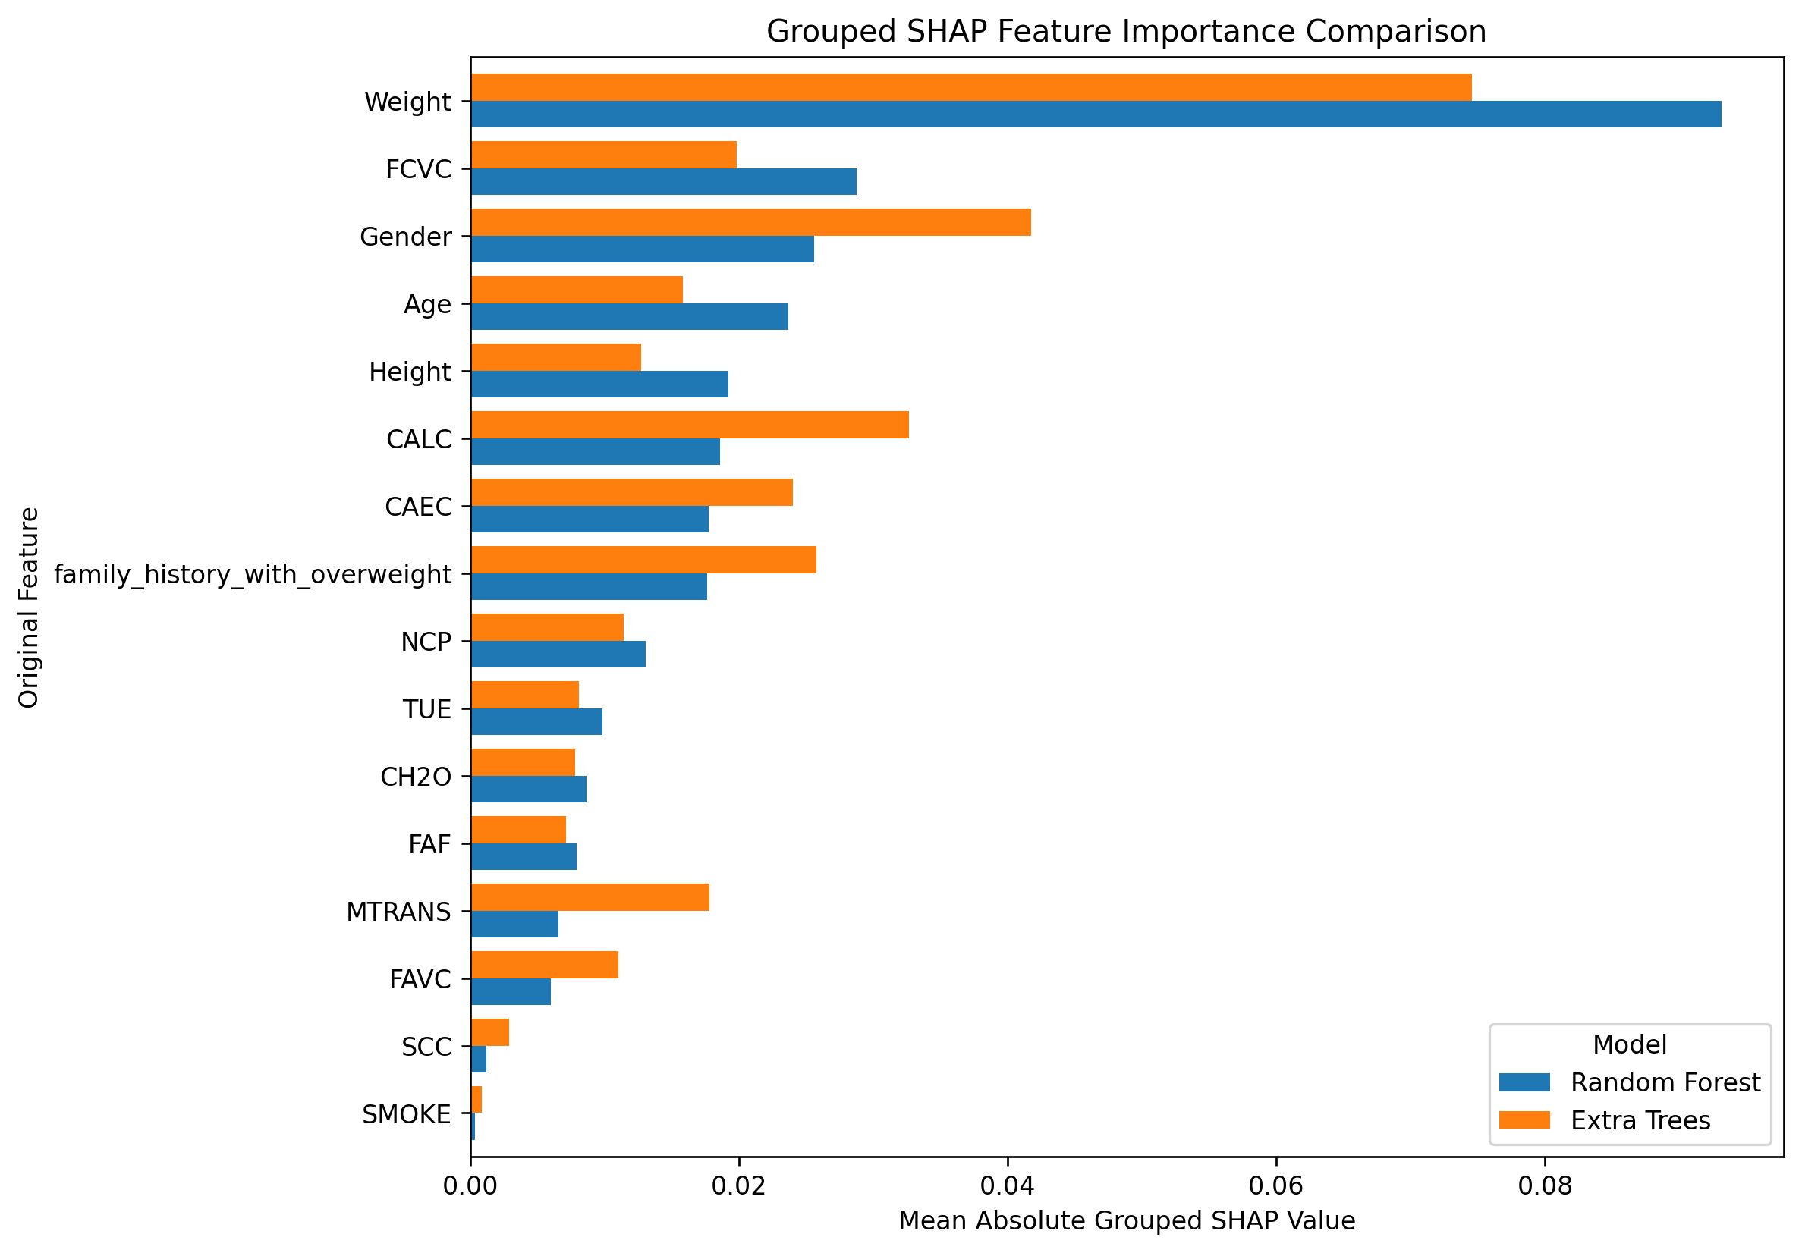
09 · PROJECT RESULTS
Confusion matrices and SHAP explanations
Test-set errors and grouped feature contributions from the uploaded notebook.
KEY EXPLANATION FINDINGS
Top-5 overlap: 40% (2 shared features: Weight and Gender)
Spearman rank correlation: 0.80
Random Forest leads test accuracy and Macro-F1 by 5.43 percentage points.
MTech AI/ML MAI
10

Slide 11
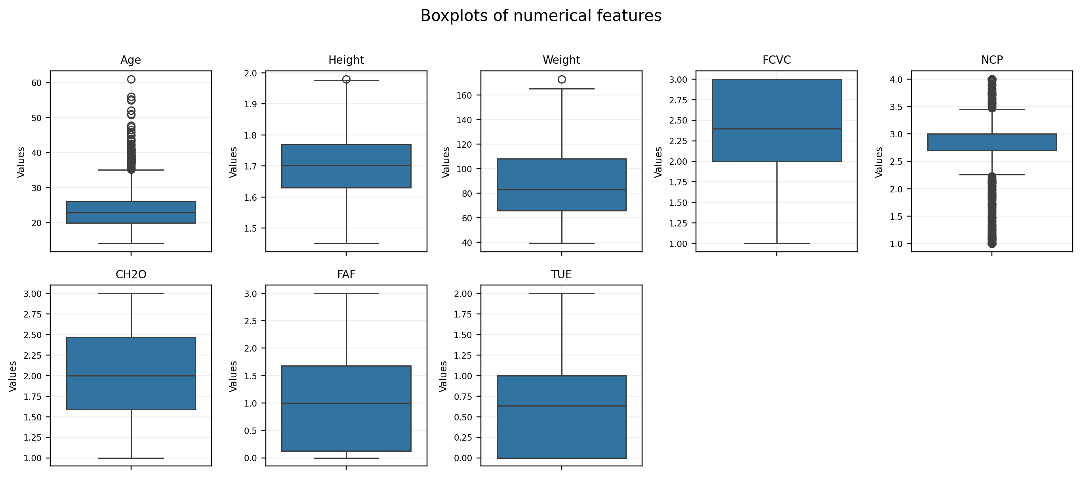
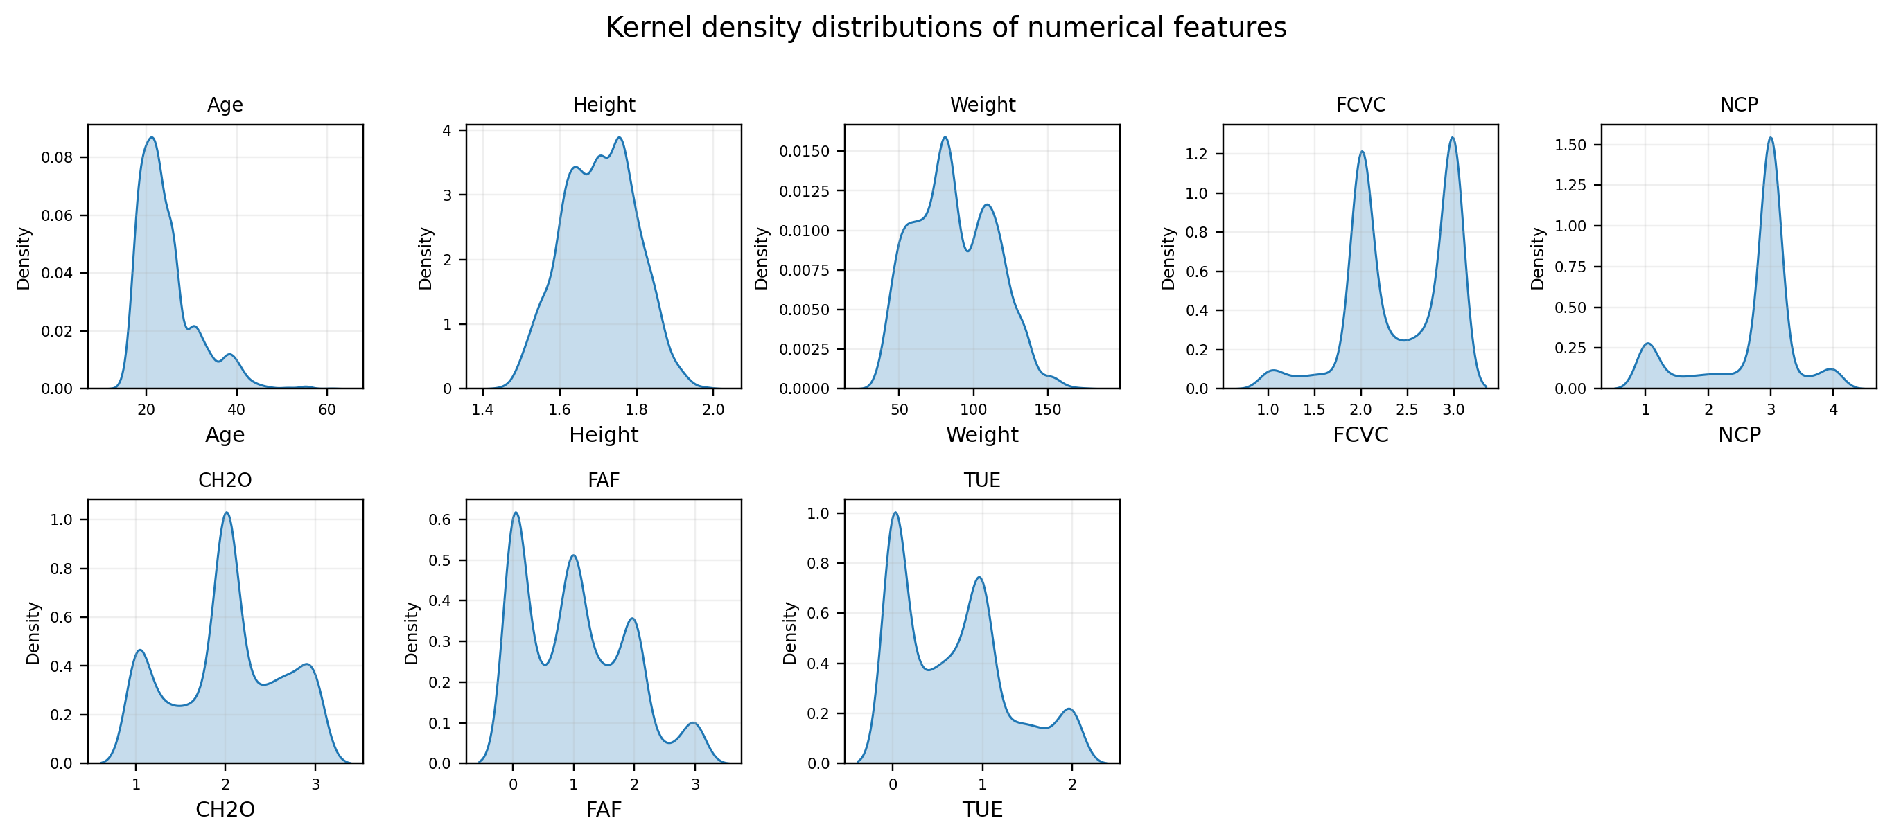
10 · DATA EXPLORATION
Numerical feature distributions
Boxplots and kernel density estimates generated from the cleaned dataset.
MTech AI/ML MAI
11

Slide 12
11 · REAL-WORLD RELEVANCE
Where can obesity-level prediction help?
Potential decision-support uses based on the project’s seven-class lifestyle and physical-condition classification task.
POTENTIAL APPLICATIONS
WHY THIS PROJECT IS RELEVANT
Screening & awareness
Multi-factor assessment
A model could help organise lifestyle and physical-condition information into obesity-related categories for awareness or follow-up discussions.
The dataset combines age, height, weight, eating patterns, water intake, activity and family-history information rather than relying on one measurement.
Personalised health programmes
Model comparison & explanation
Category-level results could help practitioners decide when to review eating, activity and water-intake habits in more detail.
Comparing Random Forest and Extra Trees, with SHAP explanations, helps examine both prediction quality and the factors influencing model outputs.
Important: this project is an ML decision-support experiment, not a clinical diagnostic tool. Predictions require professional interpretation.
MTech AI/ML MAI
13

Slide 13
12 · WRAP-UP
Thank you
Questions & discussion
PROJECT REPOSITORY
Source note
github.com/SM-Codaholic98/
MTech-AIML-Project_18_ObesityLevelPrediction
Dataset, workflow and reported results are from the
linked repository notebook. Assignment structure follows the
supplied brief.
Course : AI26501 MAI MTech AI/ML
MTech AI/ML MAI
Notes:
Close by inviting questions. Fill in the team names and ensure the final submitted repository contains the assignment-required structure and PowerPoint.

